Slide 1
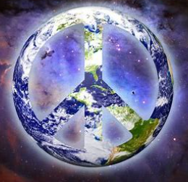
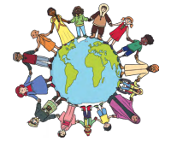
R.E. Knowledge Organiser
Promotion of Peace
Year 6: Summer Term A
Key Knowledge
Peace can mean two different things. It could be a time period without any conflict or it could mean an amount of time where you are in a state of calm or quiet with no disturbances. Peace is something that all governments and organisations aim for. Acts of peace are ways that this can be done – both as communities or as individuals. One of the important messages of Christianity is ‘Peace on earth’. This was the message from the angels to the Shepherds when Jesus was born. Peace in Judaism also focuses on ideas like prosperity (for all, not just the rich), fertility of crops, harmony and general well-being. The word Islam means submission to God. This has been important in creating peace between individuals and nations. While most Muslims are not pacifists, Muslims do not believe in starting wars. Peace is central to Hinduism. A key teaching in Hinduism is non-violence (ahimsa). This has been used to protest against oppression in India. Buddhism teaches that through meditation, you can let go of being self-centred and live peacefully and generously with each other. The founder of Sikhism was committed to nonviolence. Sikhs promote human rights and harmony and have been involved in charitable work for the poor and needy.
Vocabulary
Peace | A state or period in which there is no war or war has ended. Freedom from disturbance; tranquillity.
acts of peace | Actions that bring people closer to creating peace. These can be big actions that involve lots of people and organisations or small ones that a single person can do
conflict | Disagreements, fighting or wars.
non-violence | A commitment to resolving things peacefully.
pacifist | A person who does not believe in war or violence.
inner peace | When a person is able to make their mind calm despite stressful things that may be happening around them.
cohesion | The state of sticking together, or (of people) being in close agreement and working well together

