Slide 1
Safety at Isle of Ely: Parent Forum 2nd December 2022

Slide 2
Safety at Isle of Ely

Slide 3
School Rules

Slide 4
Behaviour policy
The role of adults (including staff, parents, governors and community visitors)
- To promote an awareness of everybody’s individual needs.
- To model pro-social behaviour and take pride in their school, their class, their work, their environment and their relationships with others.
- To ensure that all behaviour is addressed consistently and in relation to our three school rules.
- To hold a restorative conversation for all behaviour incidents.
- To treat children fairly, consistently and sensitively, demonstrating visible kindness.
- To celebrate and praise children’s achievements, successes and efforts.
- To collaborate effectively to find solutions to antisocial behaviour.
- To actively teach children about prosocial behaviour.
The role of children
- Be ready to learn.
- To show respect to other people and the school environment, acting in line with the school’s values.
- To behave in a prosocial way so that they keep themselves and others safe.
The role of parents
- To help the school develop and maintain good behaviour
- To know, understand and support the school’s behaviour policy
- To build positive relationships with the school

Slide 5
Ready
Respect
Safe

Slide 6
Behaviour curriculum
Pro-social versus anti-social
The Curriculum
We teach children how to behave in a prosocial manner through modelling, positive praise and direct teaching. Pupils are encouraged to participate actively in PSHE, PE and RE lessons as well as daily assemblies, all of which embed the school’s core values and ethos.

Slide 7
Strategies
Positive behaviour management strategies
Teaching pro-social behaviours and routines
Implementing the Thrive approach across the school
Implementing a whole school approach to the teaching of RSE and PSHE
Reviewing the development and supervision of the school inside and out to ensure provision is safe, inclusive and supports pupils’ emotional well-being
Targeting pupils with Thrive sessions
Social skills groups for vulnerable individuals and groups through Thrive
Mixed aged houses – collaboration
Ensuring playtimes are a positive experience – zoning, providing activities, maximising staff on duty, high-vis, monitoring identified hotspots
Transition

Slide 8
Alongside Thrive, we also follow the Cambridgeshire STEPS programme which aims to recognise pro and antisocial behaviour, emphasising the need to reflect, repair and restore.
- Educational Consequences
The goal for this is to stop a child’s antisocial behaviour and support them in making prosocial choices. This involves helping to teach the child to learn from their behaviour.
Example: Child running down the corridor is asked to come back and walk down the corridor at break.
- Protective Consequences
The goal is to protect and therefore keep everyone safe including the child.
Example: Child has break at a different time to his/her peers as has shown extreme antisocial behaviour.

Slide 9
Online Safety

Slide 10
Important legal documents used by school help with:
The use of technology has become a significant component of many safeguarding issues.
Impact of lockdowns
‘An effective approach to online safety empowers a school or college to protect and educate the whole school or college community in their use of technology and establishes mechanisms to identify, intervene in, and escalate any incident where appropriate.’

Slide 11
National agenda

Slide 12
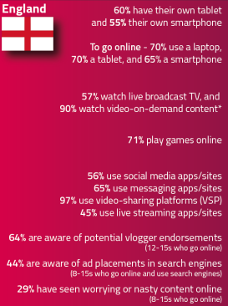
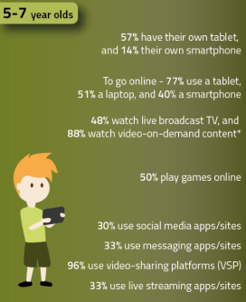
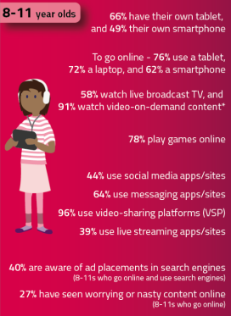
Key findingS

Slide 13
Risk vs benefit
What do those facts tell us?
What do the children we need to teach/to learn?
Today’s pupils are growing up in an increasingly complex world, living their lives seamlessly on and offline. This presents many positive and exciting opportunities, but also challenges and risks.

Slide 14
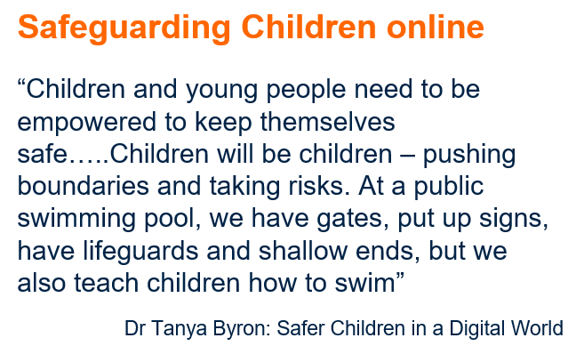

Slide 15
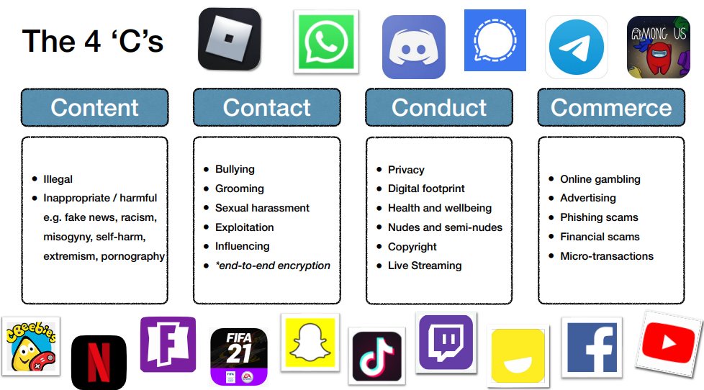

Slide 16
Education
Teaching online safety
Teach behaviours, not technology ✓
Link online and offline activity ✓
Keep it relevant - but beware ‘promoting’ behaviours ✓
Recognise shift to focus on health, wellbeing and relationships ✓
Explicitly integrate with RSE approach ✓
Make reporting easy ✓
Consider messages carefully

Slide 17
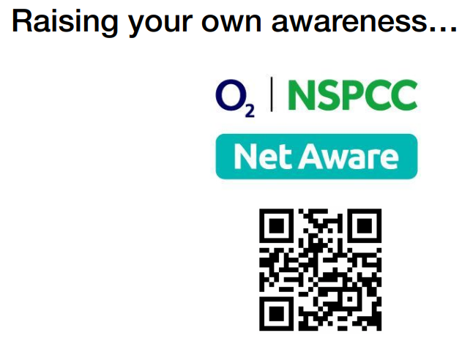
Rate yourself!
• Your knowledge of the key issues
• Your familiarity with your school’s policies
• Your awareness of children’s online activities
• The support you need
• Your readiness to respond appropriately to an incident

